Slide 1
Food Protection
Bruce Becker (CW ret.)
President
FoodQuestTQ
Notes:
Welcome to session 3 on the topic of food defense.

Slide 2
Four (4) Sessions
1. Threats to the Food Supply
2. Conducting a Food Defense Hazards Analysis
3. Food Defense Risk Assessment
4. Building a Food Defense System
Notes:
Ladies and gentlemen, we are going to talk about conducting a food defense risk assessment now.

Slide 3
The Food Defense End Game
Step 4.
Threat Assessment
Hazards Analysis
Risk Assessment
Food Defense System
Step 3.
Step 2.
Step 1.
Notes:
In our previous sessions, after we determined the threat to the food supply, we were ready to move to the second step of the process. We needed to conduct a hazards analysis of the food supply against the threats we identified in Session 1.
We knew that without an idea of the specific threat that tell you what you need to protect, why you need to protect it, and what you need to protect it against you can’t possibly go to the next step of conducting a hazards analysis. This is because any effective hazards analysis must address each of seven threat elements we identified in session 2. We also said that you must consider the capabilities of the different types of adversaries who may attempt to take advantage of each of the seven threats we identified in order to understand how to protect the different targets of attack.
So, today we are moving to the next rung on the ladder. We are going to talk about conducting a risk assessment that tells you the degree, or extent of exposure, of a specific target to the different threats and hazards that we identified in steps 1 and 2.
Of course, the end game is to build robust food defense systems that reflect the results of your threat assessment, hazards analysis and risk assessment. We will talk about this in our last session.

Slide 4
What We Will Cover Today
Food Defense Algorithm
The different food defense targets along the food supply chain
Food defense event clusters
Degrees of risk exposure for each type of food defense target based on the food defense algorithm
Growers
Transporters
Processors
Storage warehouses
Retail distribution
Food service
Grocery stores
Convenience stores
Restaurants
Notes:
We are going to discuss what we call the Food Defense algorithm as a simple but effective way to think about risk, the different types of food defense targets along the supply chain, what our scientific analysis of food defense is telling us in terms of the different threats. Finally, we will walk through the degrees of risk or extent of exposure of each of the different targets along the supply chain.

Slide 5
The Food Defense Algorithm
Probability of Occurrence (PO)
Vulnerability of the Target (v)
Consequences “worst case” of a Successful Attack (C)
PO ∫ (v) C = Food Defense Risk
Notes:
There are three parts of the food defense algorithm that can be used to scientifically quantify your degree of exposure to different threats and the hazards you are facing.
[Move to next slide]

Slide 6
Notes:
Remember those numbers that we introduced you to in lesson 1 from the POISON Metadata repository. This is where those numbers aid our scientists in determining the probability of occurrence.

Slide 7
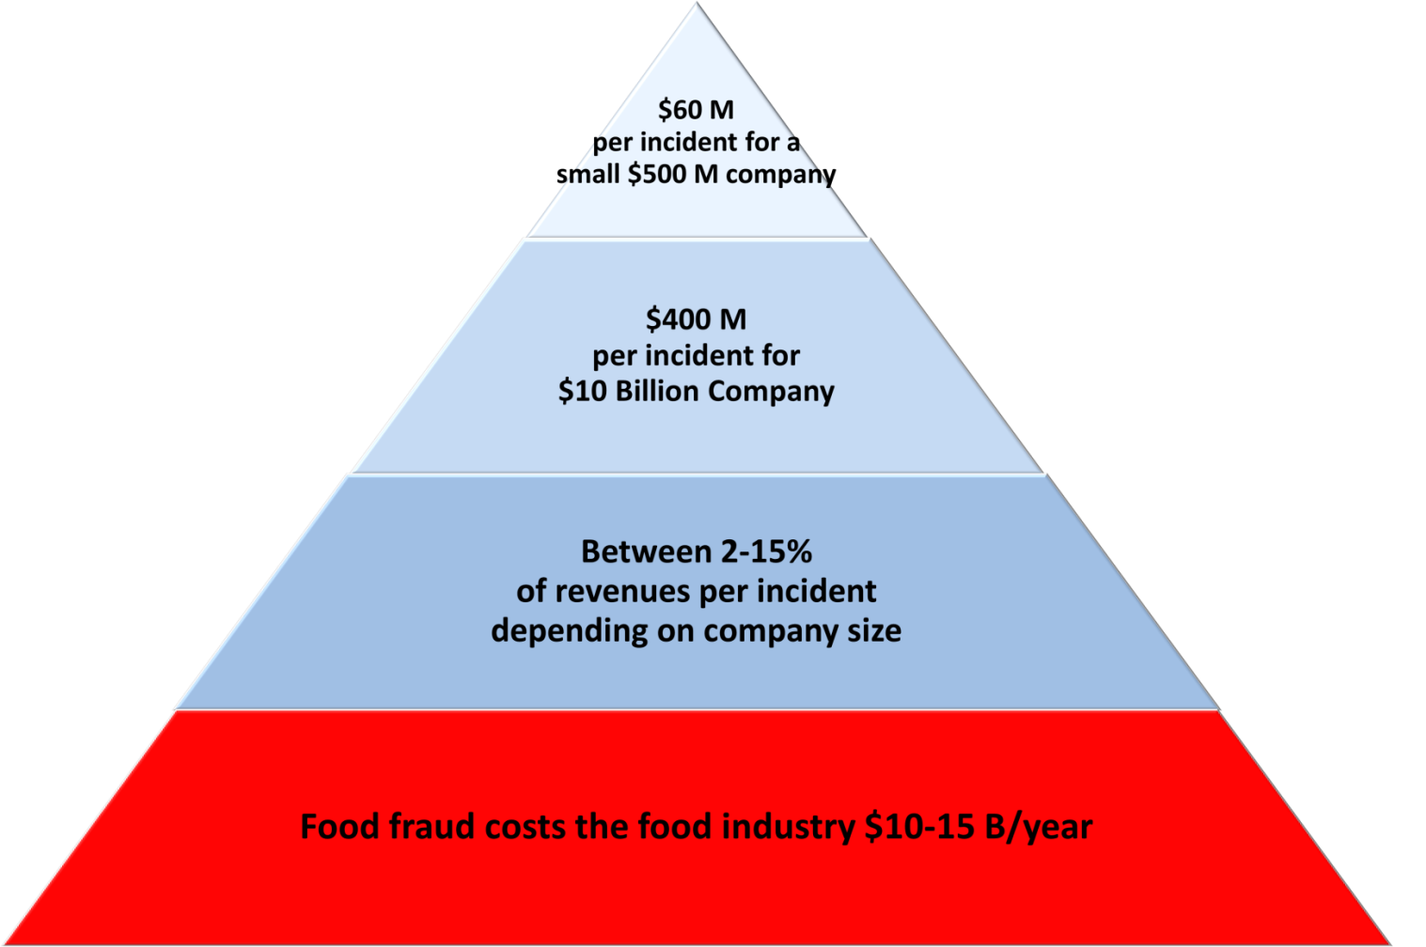
What Food Fraud Losses Mean to Individual Companies
Adapted from Consumer Product Fraud: Deterrence and Detection, GMA
Notes:
Prior to the public announcement of the current Horsegate scandal, the press reported that authorities in Ireland and Britain attempted to “keep the lid” on the problem because of strong cultural taboos against the consumption of horsemeat by major food consuming populations and the huge economic scope of the problem. The public disclosure of the Horsegate scandal came on January 15, 2013, when the Food Safety Authority of Ireland (FSAI) announced that horse meat had been found in frozen beef burgers at several Irish and British supermarkets, including Tesco, Asda, Dunnes Stores, Lidl, Aldi and Iceland.

Slide 8
Horsegate
The following day Tesco dropped 360 million euros in market value.
Notes:
In the same report we read that:

Slide 9
Showing Costs

Slide 10
The Real Numbers
PO ∫ (v) C = Food Defense Risk
9 x 9 = 81% for Horsegate
Notes:
Now I’m not a mathematician both 81 out of 100% is a mathematical significant issue

Slide 11
Determining Food Defense Risk
Probability of occurrence
Different from “likelihood” based on subjective opinion
Based on statistical analysis of past and simulated future events based on:
Type of target
Location
Agents used
Adversary type and characteristics
Location on the supply chain
Specific commodity
Other factors
Strategic, operational and tactical intelligence
Continuous scanning of the threat environment
Imminent threats
Emerging threats and changing adversary modus operandi
Notes:
Now one thing I have been told to tell you by our Chief Science Officer who wanted to come just to drink the beer is to never confuse the term “likelihood” with the term “probability.” People frequently make the mistake of thinking that the two terms mean the same thing. They don’t!
Likelihood of occurrence is based on anecdotal impressions of the threat environment and the hazards you face. It is an opinion. It is subjective. It is not the stuff of science.
Probability of occurrence is very different. It is based on scientific analysis, the quantification of values and their statistical treatment. The quantification of the challenge is everything in science-especially when it comes to establishing scientific probabilities.
Determining food defense probabilities require the quantification of numerous variables based on an analysis of data. It also requires the continuous scanning of the threat environment to quantify any changes in your extent of exposure to different threats and the hazards they pose for your operation

Slide 12
Continuous Intelligence Scanning
Imminent threats
Copycat events
Changes in Modus Operandi
Organized Crime and Economically Motivated Food Adulteration
Includes supply chain validation based on “trust but verify”; price pointing; chain of custody certifications; frequency of occurrence based on forensic analysis and other indicators and warnings
Notes:
When you continuous scan the threat environment you are looking at thinks like:
HUMINT/COMINT/SIGINT of intended attacks
Copycat events because we know there is a scientific correlation between an event, like a mass shooting for example, and the scientific probability of other events clustering around the first
Changes in how adversaries can and must attack. In other words what can or must they do in very specific terms to achieve the success they desire.
The presence of organized crime based on the scientific analysis of things like the Horsegate, Honeygate (Groeb) and/or the Peanut Butter Corporation of America scandals.
Continuous intelligence scanning also includes “trust but verify” when it comes to the procurement and traceability of food product both upstream and downstream of your specific position on the food supply chain.

Slide 13
Company Watch List

Slide 14
Vulnerability of the Target (v)
Perceived or actual vulnerability of the target by potential adversaries
Physical security
The availability of information useful to the adversary
Ability to infiltrate the operation
A target is only as hard as it’s weakest link
A risk assessment considers each threat and the results of your hazards analysis by:
Adversary type
Location on the supply chain
Commodity type
Notes:
Now let’s think about vulnerability. Your vulnerability depends on the perception of your adversary and whether he/she believes he/she can succeed in obtaining their desired outcome. Of course, desired outcomes vary by adversary type-crusaders, criminal and crazies.
Any target is only as strong as its weakest critical link. This means that you have to find the critical links and determine if they are strong enough to prevent a break in the chain.
This is what a risk assessment is all about- can you protect yourself against a range of different threats and the hazards they create.

Slide 15
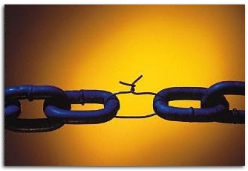
Something to think about…
Notes:
But the bottom line for all aspects of food protection whether it’s for food defense or food safety is that you are only as strong as your weakest link.

Slide 16
Questions
What do you think are the weakest links of the food supply system and why?
What are the levels of risks associated with each critical link?
Are we doing enough in view of the threats and hazards you identified?

Slide 17
Food Defense Targets and Event Clusters
Food Defense Targets
Growers (G)
Processors (P)
Transporters (T)
Event Clusters
Intentional poisonings (IP)
Food fraud (FF)
Warehouses (W)
Retail Distributors (RD)
Grocery Stores (GS)
Food Service (FS)
Convenience Stores (CS)
Restaurants (R)
Intentional adulteration (IA)
Sabotage of food facilities (S)
Cyber attack (CY)
Attacks against personnel (AP)
Notes:
Now that we have defined what needs to be protected, why it needs to be protected, and what it needs to be protected against in a comprehensive statement of the threat to the food supply, we can now determine the risk or degree of exposure of the types of different food operations along the food supply chain.
Our scientists back home looked across food growers (G), processors (P), transporters (T), warehouses (W), retail distributors (RD), grocery stores (GS), food service (FS), convenience stores (CS) and restaurants (R).
They found five clusters of events during their analysis of food events in POISON and from the open source intelligence. Based on the growing incidence and seriousness of computer-attacks that were found in conducting the open source intelligence analysis they identified and added the sixth cluster of cyber sabotage.

Slide 18
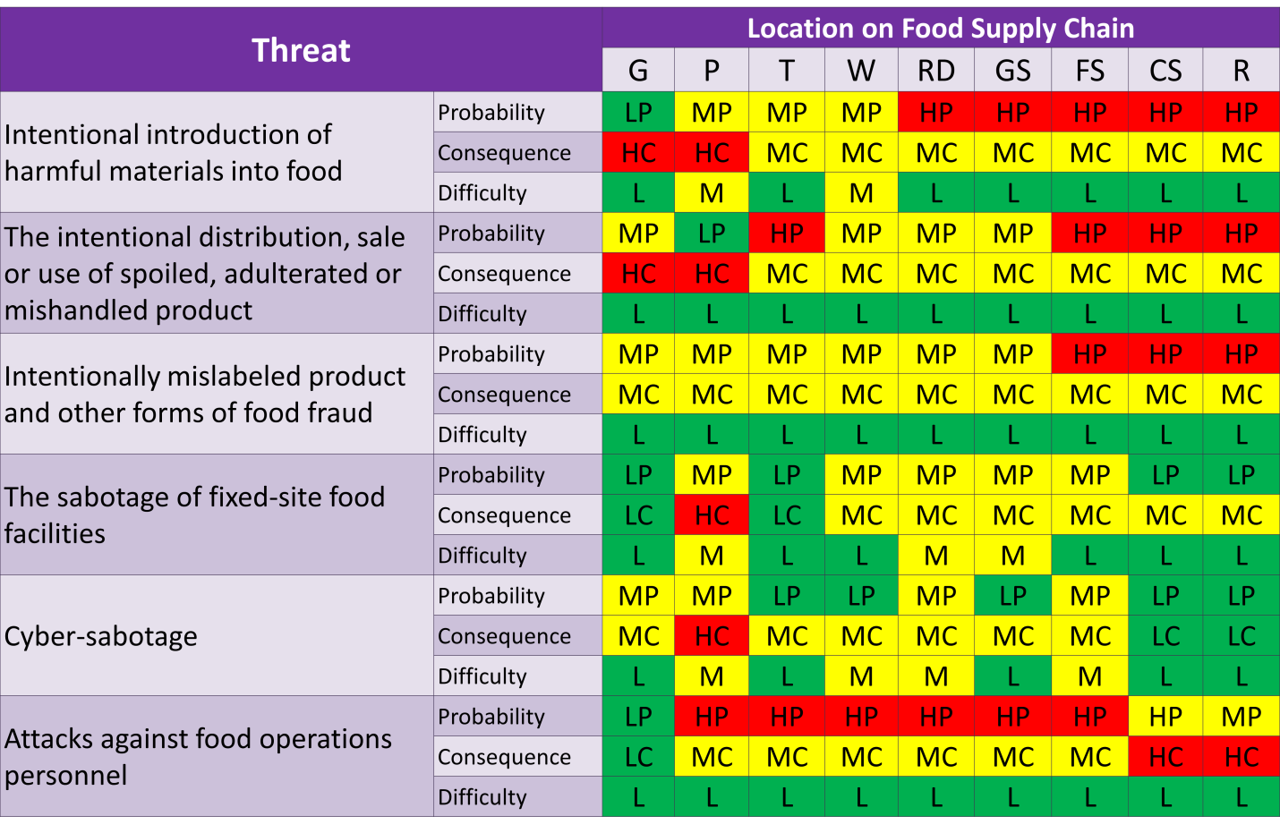
Food Defense Degree of Exposure Matrix
Notes:
A traffic light approach of red to represent high, yellow to represent medium and green to represent low is used to signify the probability, consequence and difficulty associated with the different clusters of events across each segment of the food supply chain.
Difficulty means the motivation, access to the materials necessary to mount a successful attack, and the know-how to plan and execute a successful attack.
The probability of the event occurring is based on data in POISON and the analysis of open source intelligence including financial losses resulting to the food industry. Past events of a similar nature in POISON and the analysis of open source intelligence (including economic losses) were used to estimate consequence.
Knowledge of adversary motivation, access to the materials to carry out an attack and the know-how to estimate the difficulty of attacking the different segments along the supply chain were drawn from open source intelligence analysis and used to assign a “difficulty” benchmark.
As part of the risk assessment, events from the POISON database and from open source intelligence were analyzed and used to assign probability of occurrence (PO) and consequence rankings for the introduction of harmful materials, the distribution and sale of spoiled and mishandled product, intentional mislabeling and other forms of food fraud, the sabotage of fixed site facilities, cyber-sabotage and the protection of food operations personnel including retail customers.
A traffic light approach was used to signify levels of concern. Red indicates the highest level of concern. All threat events with a high consequence, regardless of their probability of occurrence are marked in red. For example, even though the probability of someone intentionally introducing foot and mouth disease at several U.S. beef farms is low, the consequences could have a devastating impact on the beef industry and U.S. agricultural exports. In another example, even though the probability that a terrorist group could successfully introduce enough of the right toxin or biological agent into a large enough food batch to result in a catastrophic outcome is low, the consequences of a successful attack could have devastating consequences. In a final example, although the probability that an act of violence will occur at a retail distributor, grocery store, convenience store and a restaurant ranges from low to medium probability of occurring, the results have proven to be devastating in terms of loss of life and brand name risk exposure for many of the companies involved, so they appear in red.
In similar fashion, yellow represents a very serious level of concern. All medium consequence events appear in yellow. Yellow signifies that while the impact of such an event would have very serious consequences on the company involved the outcome is still manageable.
Green signifies that the event is manageable. All low consequence events appear in green. Green signifies that while such an event will adversely impact the company involved, the outcome is manageable.

Slide 19
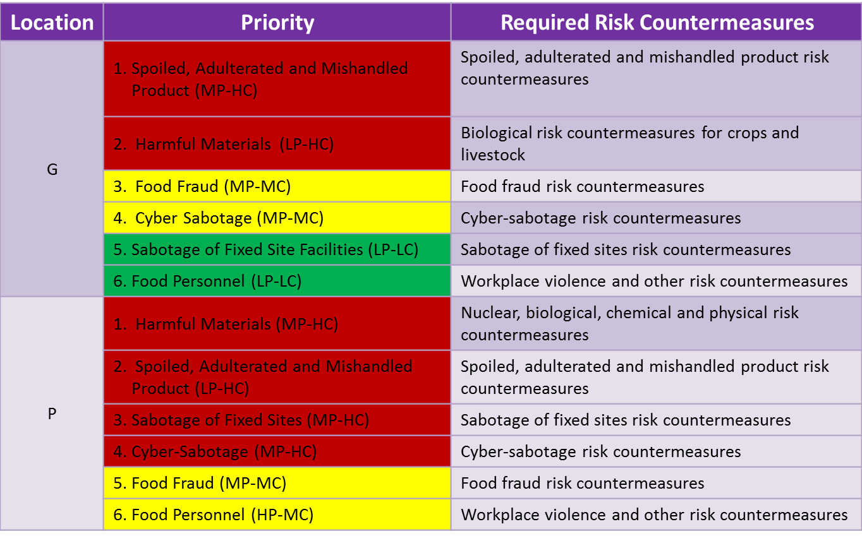
Degree of Exposure for Growers and Processors
Notes:
In the following series of figures we show, in rank order, the specific threats of concern to food growers (G), processors (P), transporters (T), warehouses (W), retail distributors (RD), grocery stores (GS), food service (FS), convenience stores (CS) and restaurants (R) and the associated risk countermeasures that should be emphasized.
The occurrence of major food poisoning incidents and the introduction of spoiled, adulterated or mishandled product leading to criminal indictments and civil litigation for negligence have become major concerns for growers. In a growing number of cases, serious poisoning incidents have forced these companies out of business. For growers, the introduction of the right type of undetected toxin or biological agent into a large batch of food product could also have devastating consequences. The possibility of food fraud and cyber-sabotage (medium and large growers for traceability) would have medium consequences. The sabotage of building structures and violence against farms and farmers is considered to be a low probability and low consequence event.
Food processors have the greatest risk exposure of any single segment along the food supply chain. Although the probability is low, if the right toxin or biological agent were successfully introduced into a large batch the consequences could be devastating. In complex supply chains that allow for the fast and broad distribution of food both spoiled, adulterated and/or mishandled product and food fraud could have devastating impact on brand name. Processors are the most vulnerable to the sabotage of fixed sites with potentially devastating consequences. Cyber-sabotage could threaten food production, distribution and traceability to result in devastating consequences. Finally, the consequences of violence involving food personnel is considered as a medium consequence event due to the high cost of reparations and negative effects on employee morale and resulting decreases in production.

Slide 20
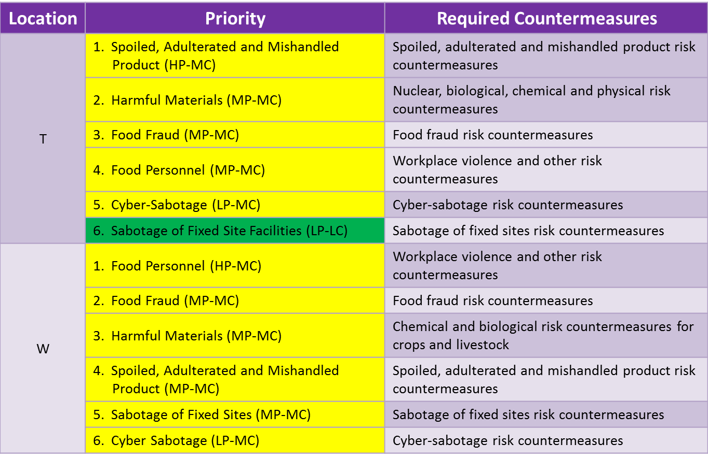
Degree of Exposure for Transporters and Warehouse Facilities
Notes:
For transporters the threats posed by the introduction of harmful materials, the distribution of spoiled, adulterated and mishandled product, food fraud, cyber sabotage and driver safety issues associated with the frequency of truck hijackings are all medium consequence events. As would be expected, the probability of occurrence and consequences associated with the sabotage of fixed site facilities are low for transporters.
Warehouses face medium consequences across all six threat areas.

Slide 21
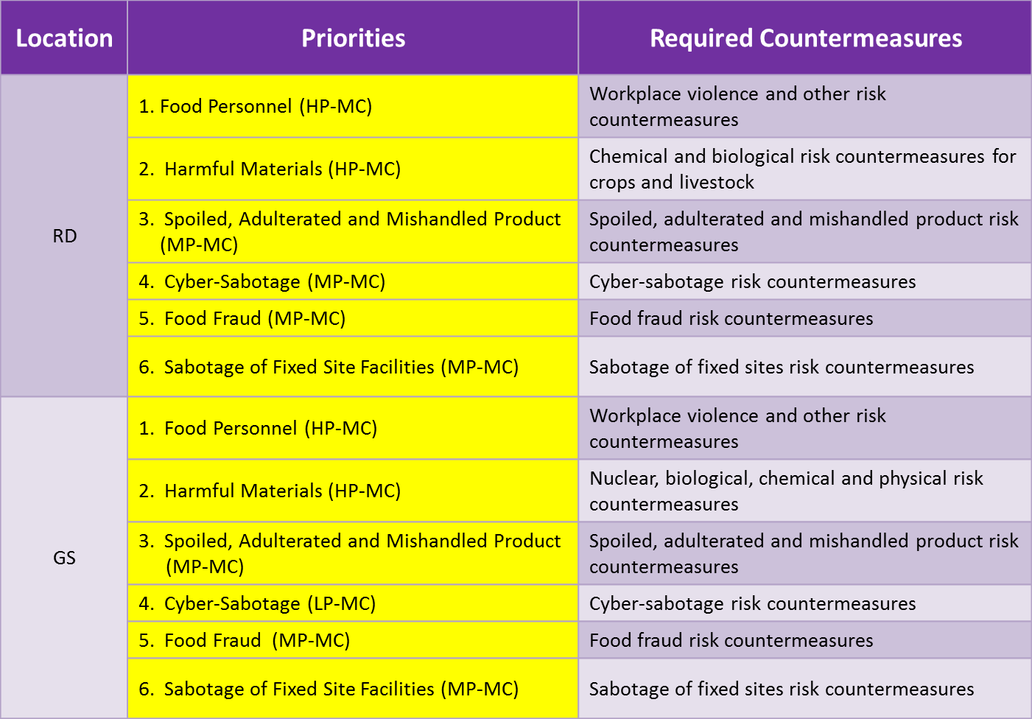
Degree of Exposure for Retail Distributors and Grocery Stores
Notes:
For retail distributors the priority concern is violence affecting retail establishments of all kinds. The violence may be among employees or by outsiders. The consequences of violence, especially shootings, make retail food stores extremely vulnerable to after the fact adverse brand name exposure. The introduction of harmful materials, spoiled and mishandled product, cyber-sabotage, food fraud and sabotage to fixed facilities are all considered to be medium consequence events.
Grocery stores are assigned the same ranking as retail distributors for the same reasons.

Slide 22
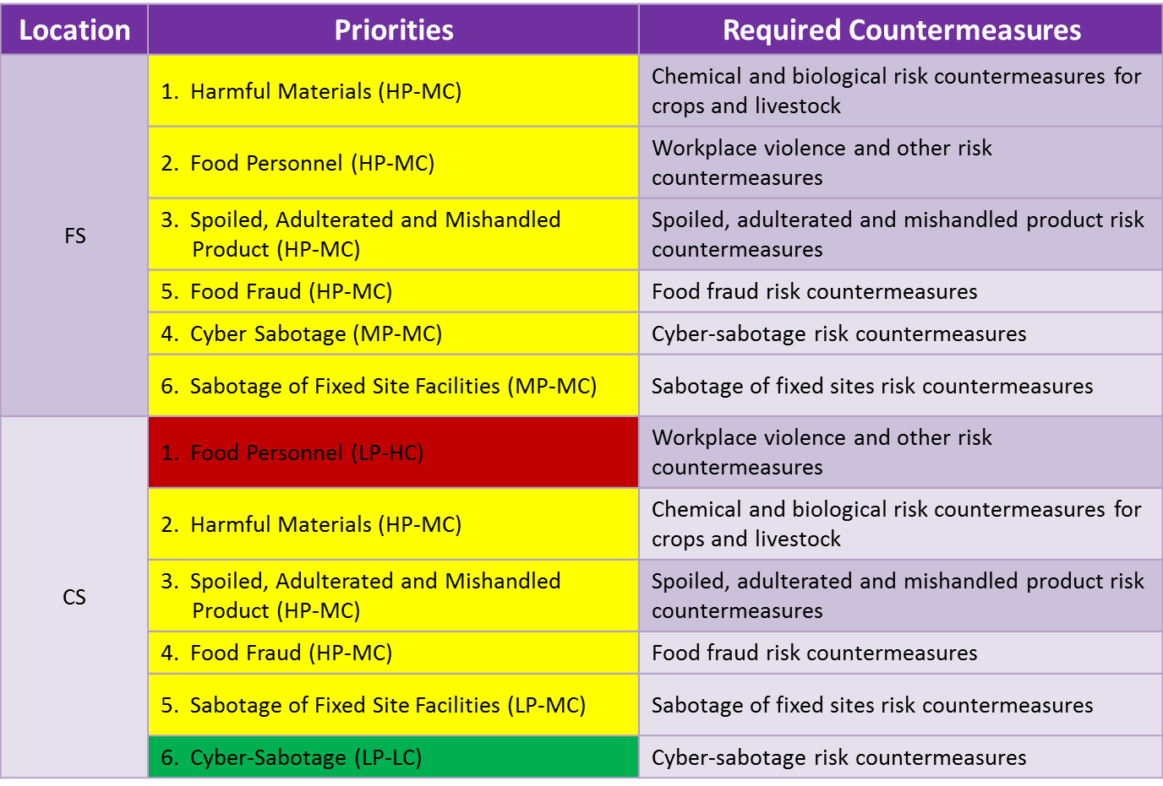
Degree of Exposure for Food Service and Convenience Stores
Notes:
Like warehouses, food service establishments face medium consequences across all six threat areas.
Convenience stores, like other food retailers, face the threat of violence against personnel. The violence is usually instigated by outsiders and robbery attempts. The consequences of violence, especially shootings, make convenience stores extremely vulnerable to after the fact adverse brand name exposure. The introduction of harmful materials, spoiled and mishandled product, food fraud and fixed site facility sabotage (not involving workplace violence) are considered to be medium consequence events for convenience stores. The probability and consequences of cyber-sabotage are considered low.

Slide 23
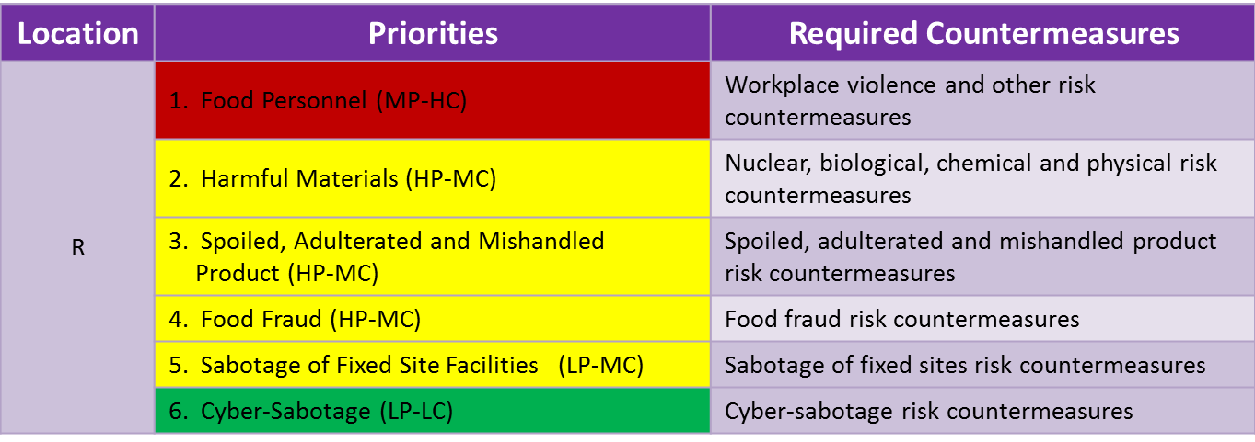
Degree of Exposure for Restaurants
Notes:
Finally, restaurants like other food retailers face the threat of violence against personnel and their customers. The violence is frequently instigated by outsiders and may involve mass shootings. The consequences of violence, especially shootings, make restaurants extremely vulnerable to after the fact adverse brand name exposure. The introduction of harmful materials, spoiled and mishandled product, food fraud and fixed site sabotage are considered to be medium consequence events for restaurants. The consequences of cyber-sabotage are considered low.

Slide 24
Summary of Sessions 1, 2 and 3
Food protection are based on:
What needs to be protected, why it needs to be protected and what it needs to be protected against
They type of adversary you are dealing with
Crusaders, criminals or crazies
Your specific location on the supply chain
Grower, transporter, processor, storage warehouse, retail distribution, food service, grocery store, convenience store or a restaurant
Your degree of exposure
The things you do to deter, detect, communicate, delay, respond quickly and respond effectively to food defense incidents relative to your degree of exposure
Notes:
OK. That’s it for Session 3. So, let’s end the session by very quickly summing up where we are at after completing sessions 1 through 3.
In session 1 and 2 we talked at length about the importance of determining what needs to be protected, why it needs to be protect and what it need to be protected against. The very basic requirement before you can even begin to think about building an effective food defense system.
We also said that the threats and the hazards associated with them depend directly on the type of adversary you are dealing with- crusaders, criminals or crazies, your specific location on the supply chain and the commodity you are dealing with.
In Session 3 we talked about quantifying levels of risk based on your degree or extent of exposure.
I’d like to conclude Session 3 by saying that the things you do to deter, detect, communicate, delay, and respond to food defense incidents are the basic elements of any robust food defense plan.
In Session 4 we will bring everything we presented in Sessions 1, 2 and 3 together to talk about how to build a robust food defense plan.

