Slide 1
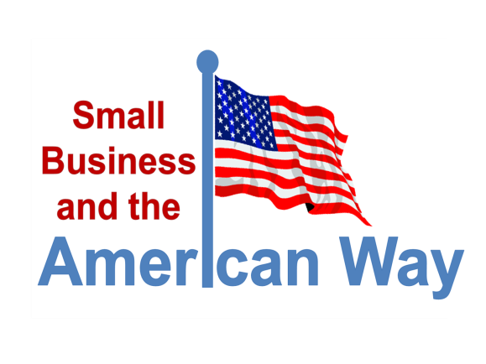
Research Integrity in Peril: Plagiarism by the Food and Drug Administration
John H. Hnatio
Chief Scientist, FoodQuestTQ LLC
September 6, 2013
Notes:
Hello. This You Tube presentation is about intentional plagiarism by the federal agency that all of us depend on for the safety of the food we eat and the medicines we take.
It involves the theft and plagiarism of a scientist’s work by the FDA without giving him credit for a ten year program of research. It is about stealing his research in order to compete with his small company to force him out of business.
I know the story very well because I am the victim of the FDA’s lack of research integrity. I am Dr. John Hnatio.

Slide 2
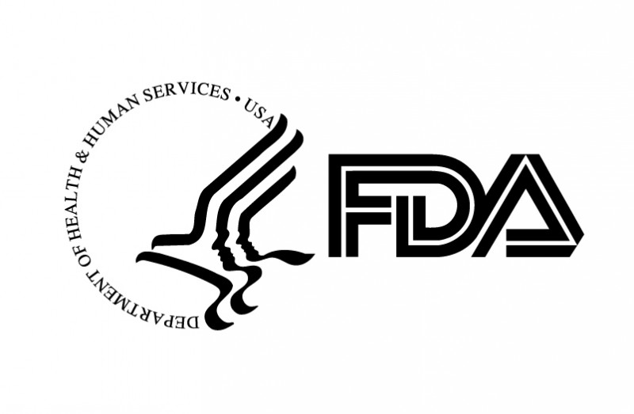
Research Integrity in Peril: Plagiarism by the Food and Drug Administration
Notes:
I want warn those of you that may already be worried about the safety of the food we eat and the medicines we all take, this presentation may not be pleasant to watch.
The Food and Drug Administration or FDA is one of the world’s largest research agencies when it comes to the safety of food and medicines. The integrity of the research conducted by the FDA translates directly to the safety of the food we eat and the medicines we take.
When researchers plagiarize their work they put all of our lives at risk because their false claims can become the building blocks for subsequent research. If subsequent research is built on a faulty foundation the entire house of cards can fall down. The integrity of the research conducted and overseen by the FDA can literally make the difference between life and death.

Slide 3
Accidental or Deliberate
http://classguides.lib.uconn.edu/content.php?pid=50827&sid=386249
Notes:
The story I am going to share with you today is about how the FDA is violating research integrity by plagiarizing the work of others. The situation is really no different that catching a high school or college student stealing the work of others in order to write a term paper. Perhaps the only real difference is that the student is likely to be expelled from school while the government ignores their own behavior.
So what is plagiarism? Among the most visible indicators of plagiarism is simple laziness- the failure to research something before you write it. In other words you just write things down without finding out who may have already done the very same things that you are trying to do.
Another indicator of plagiarism is not knowing what common knowledge is. What you think is common knowledge had to originate somewhere.
Another important indicator of plagiarism is re-phrasing someone else’s ideas in order to disguise them as your own. This is perhaps the most serious form of plagiarism.

Slide 4
Examples of FDA Plagiarism of FoodQuestTQ Products
Pre- 2007 FQTQ Research
2007 FDA Food Protection Plan
Notes:
I began my doctoral research in 2002 while I was attending the George Washington University. This was long before the Congress and others became concerned about the failure of the FDA to “look ahead” to prevent food poisoning instead of just waiting for something to happen. In 2002, what is now common knowledge was a new way of thinking about things.
Here is just one of literally hundreds of ideas the FDA stole from my doctoral research and dissertation over the past five years.
For example, the idea in my research portrayed here was simple-if you can prevent something bad from happening in the first place it’s better than just waiting around to pick up the pieces afterwards.
This is just one of hundreds of examples of the plagiarism of my research contained the FDA Food Protection Plan- the guiding policy document used by the government to protect the food we all eat. A compendium of stolen ideas.

Slide 5
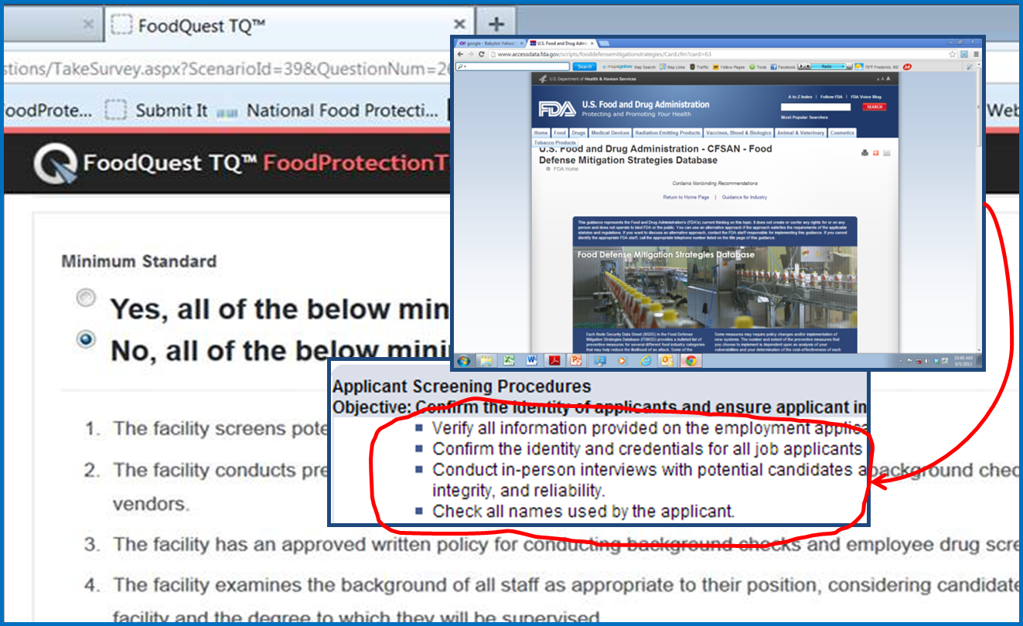
Examples of FDA Plagiarism of FoodQuestTQ Products
FQTQ: Food DefenseTQ
FDA: Mitigation Strategies Database
Notes:
In 2008, we began to build the world’s most advanced computer software for risk management.
Our thinking was quite revolutionary at the time and it was this early research that gave birth to much of the new thinking that is taking place today in the food industry.
The new ideas conceived way back then have become the new buzz words of today’s food industry, words like science and risk based, quantitative versus qualitative, event path analysis, critical nodes, prevent versus just react and so on and so on.
Our first computerized tool, FoodDefenseTQ (with TQ standing for threat quotient), involved the development of a set of criteria that were proven to mitigate against both the occurrence of and responses to food related events.
Food DefenseTQ was developed and used long before the FDA plagiarized and duplicated it with the release of FDA’s Food Defense Mitigation Strategies database.

Slide 6
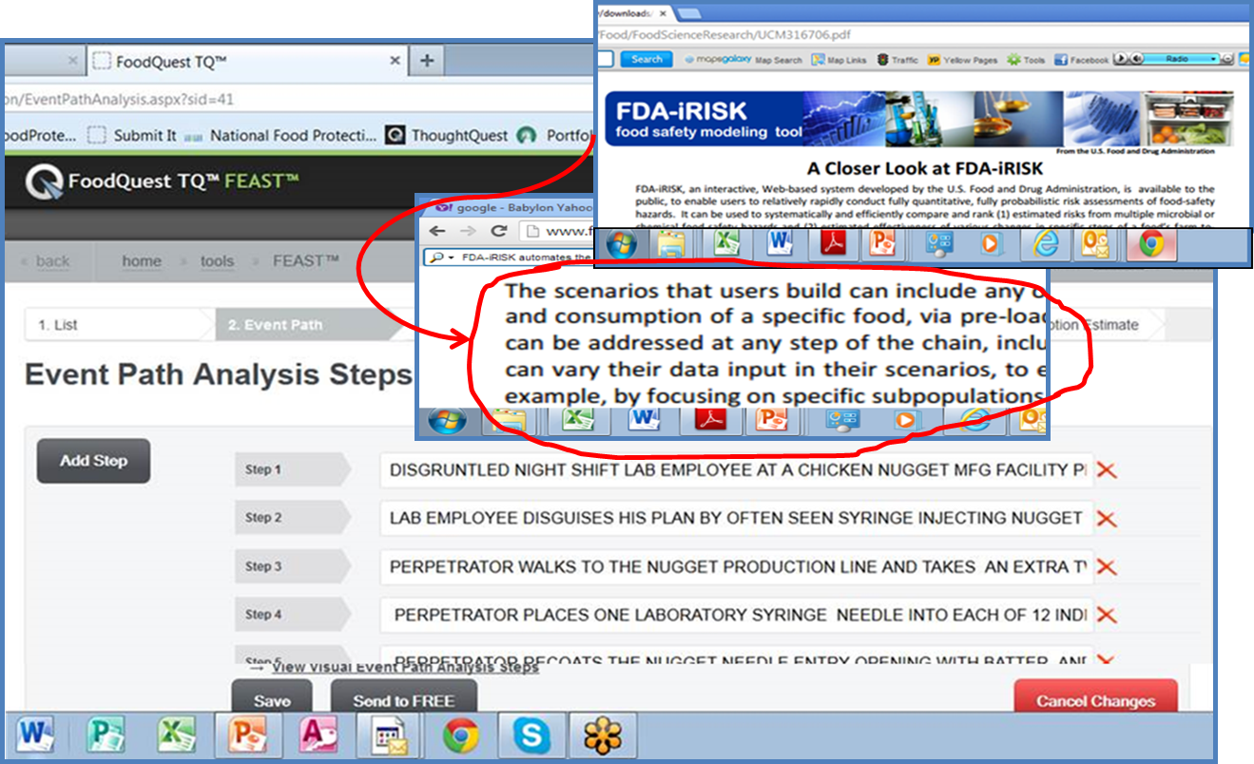
Examples of FDA Plagiarism of FoodQuestTQ Products
FQTQ Food Event Analysis and Simulation Tool (FEAST)
FDA: iRisk Tool
Notes:
The FDA iRisk tool is another example. In this case the FDA duplicated the ideas of using computational analysis to support food event scenarios. Just like our Food Events Analysis and Simulation Tool or FEAST the FDA iRisk tool allows you to structure and apply risk values along an event path. FEAST long pre-dated the development and release by the FDA of their iRisk tool.

Slide 7
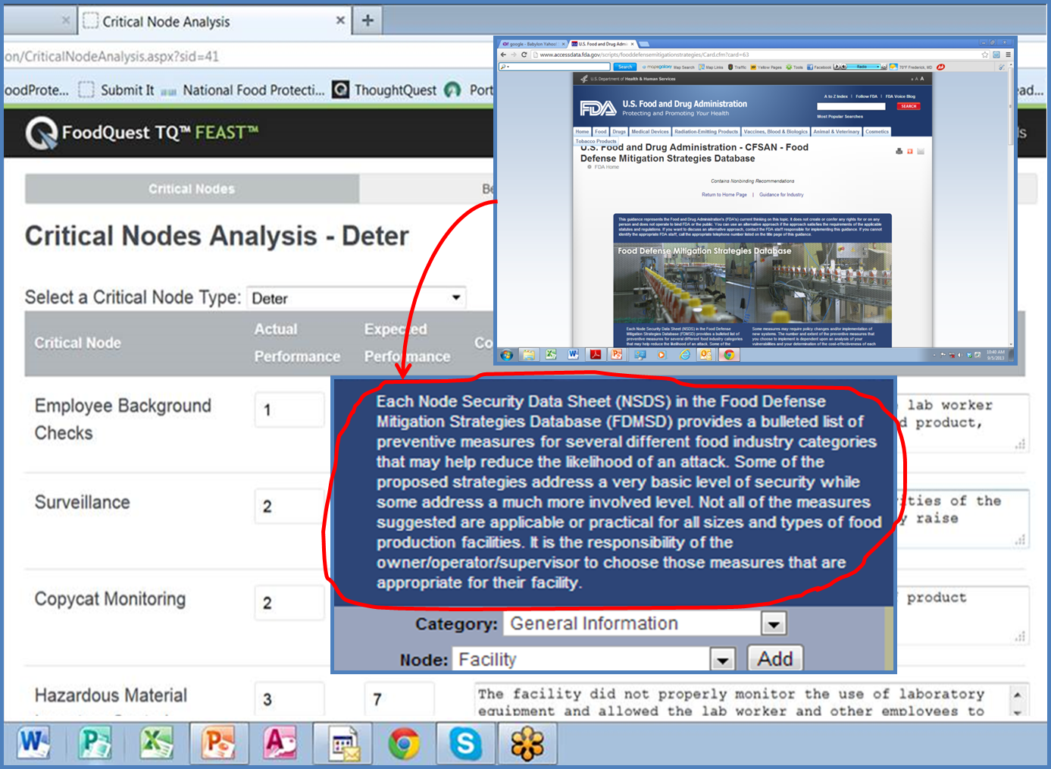
Examples of FDA Plagiarism of FoodQuestTQ Products
FQTQ: Food Event Analysis and Simulation Tool (FEAST)
FDA: Mitigation Strategies Database
Notes:
In another blatant example of plagiarism, the FDA steals the idea of identifying and using the nodes of the food supply system to identify preventive measures to stop food defense events. Long before the FDA developed their Food Defense Mitigation Strategies database, we had already developed and were using the idea as part of our Feed Event Analysis and Simulation Tool or FEAST.

Slide 8
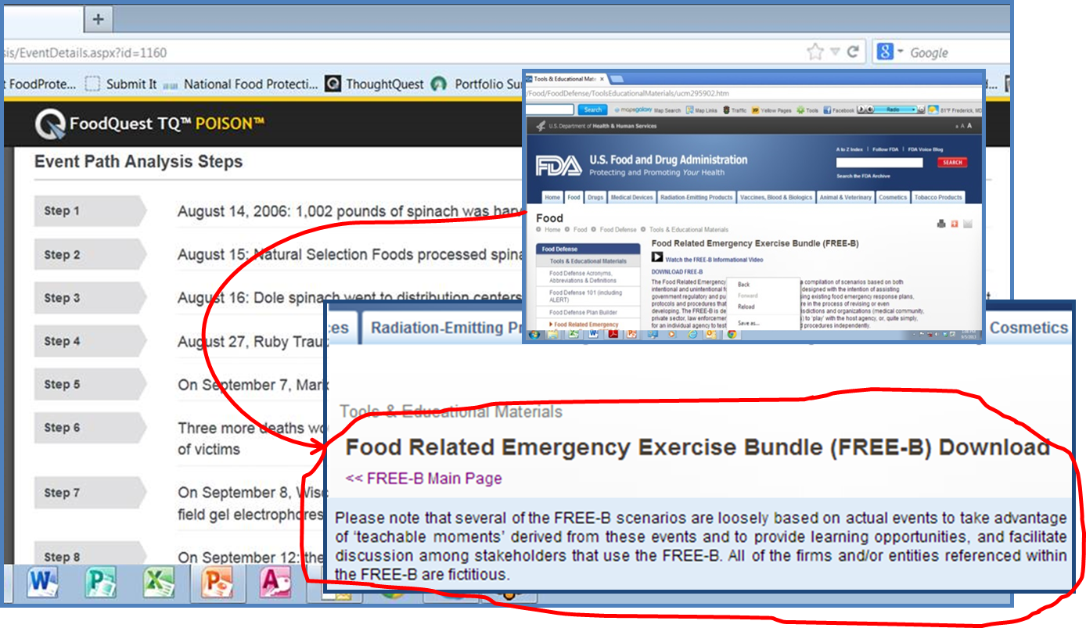
Examples of FDA Plagiarism of FoodQuestTQ Products
FQTQ: POISON Metadata Repository
FDA: Food Related Emergency Exercise Bundle (FREE-B)
Notes:
One of the new tools we developed was called POSON. POISON is a metadata repository of intentional and unintentional food events. We use POISON and our other tools to develop scenarios that are loosely based on real world events to create simulations of food related emergencies.
Our research and methods to create these type of simulations in POISON long pre-dated any similar work by the FDA to produce their own web based version of our tool.

Slide 9
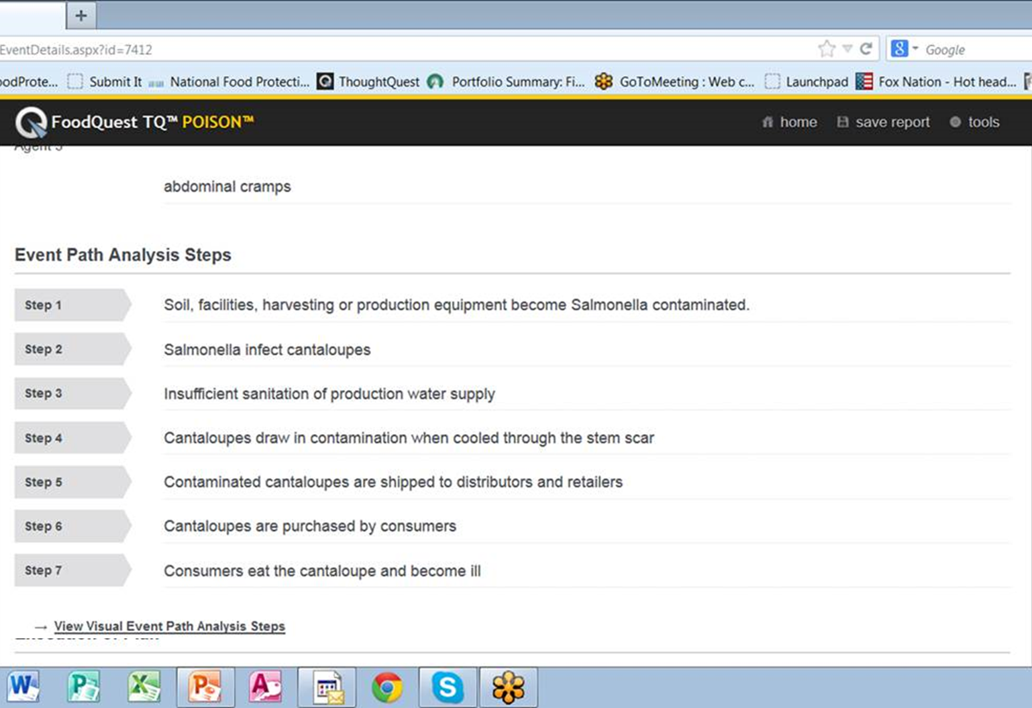
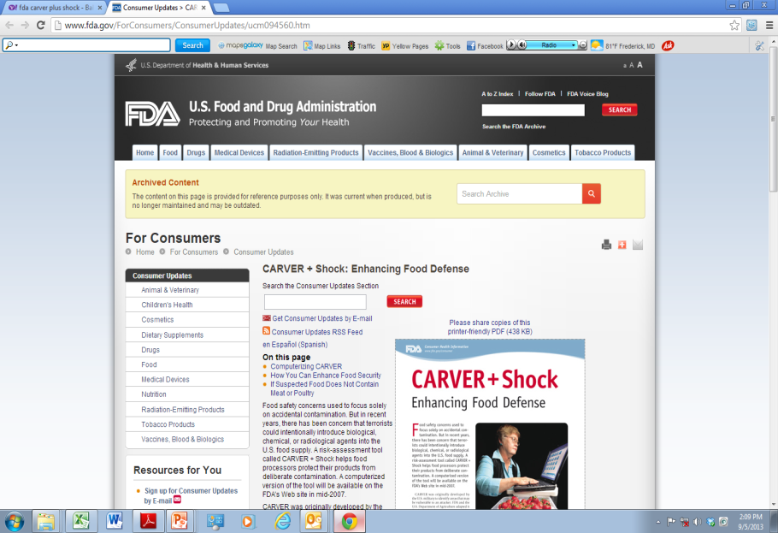
Examples of FDA Plagiarism of FoodQuestTQ Products
FQTQ: POISON
FDA: Post 2007 FDA Updates to C.A.R.V.E.R. plus SHOCK
Notes:
Shortly after 9-11 the FDA decided to use a vulnerability assessment tool that was originally developed by the Army Special Forces in the 1950’s to target enemy infrastructures during wartime. The use of C.A.R.V.E.R. plus SHOCK is now the cornerstone of FDA’s counterterrorist efforts in protecting the food supply. I am extremely familiar with C.A.R.V.E.R. plus Shock based on my work with Sandia ant other National Laboratories in the 1980’s.
Since the 1950’s there have been numerous updates to C.A.R.V.E.R. plus SHOCK but many of the post 2007 changes to the FDA’s computerized application of C.A.R.V.E.R. plus SHOCK now contain ideas that are plagiarized from our POISON Metadata Repository.
As this slide demonstrates, the FDA has simply taken our idea of event path steps and simply re-named them as “templates.” An example of the type of “patchwork” plagiarism that can only be intentional.

Slide 10
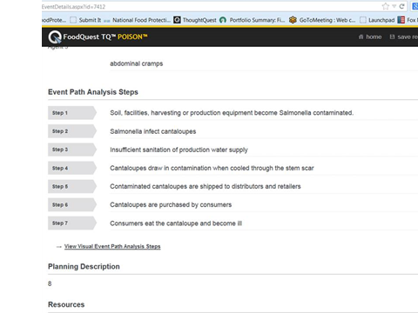
Examples of FDA Plagiarism of FoodQuestTQ Products
FQTQ: POISON Metadata Repository
FDA: Post 2007 FDA Updates to C.A.R.V.E.R. plus SHOCK
Notes:
Here’s another example. In our POISON Metadata Repository we build event sequences that consist of each causal step in a process.
Here the FDA has simply taken the idea and added a graphic interface. Another example of intentional plagiarism.

Slide 11
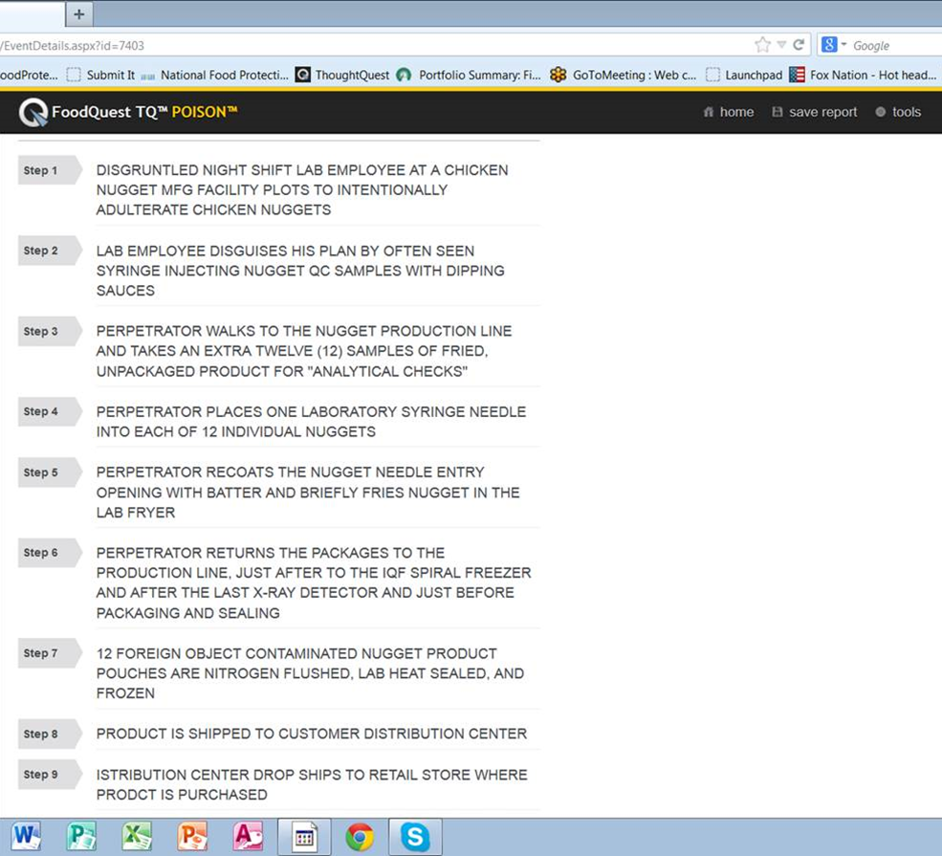
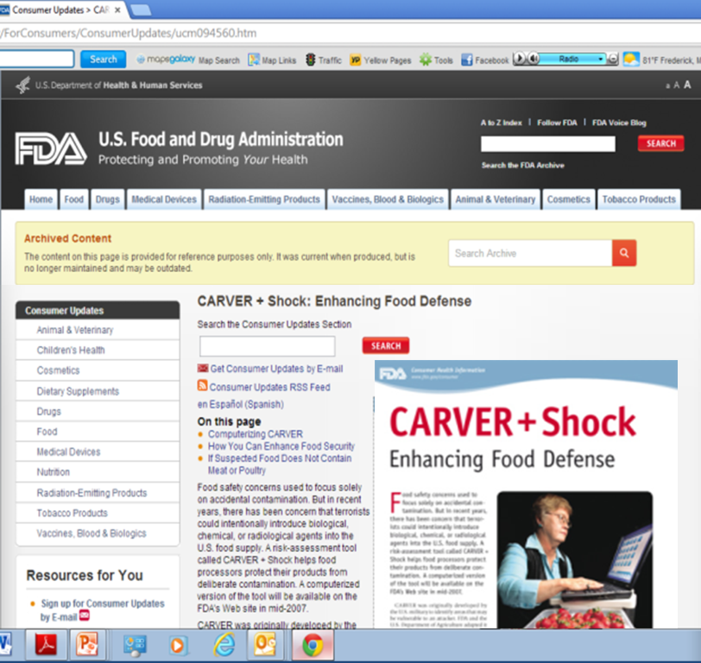
Examples of FDA Plagiarism of FoodQuestTQ Products
FQTQ: POISON Metadata Repository
FDA: Post 2007 FDA Updates to C.A.R.V.E.R. plus SHOCK
Notes:
Here is yet another example where C.A.R.V.E.R. plus SHOCK has been updated by stealing the research of others.
In this case, the FDA has taken our idea of expressing the relationships that we set forth in our POISON database and simply added a graphic interface.

Slide 12
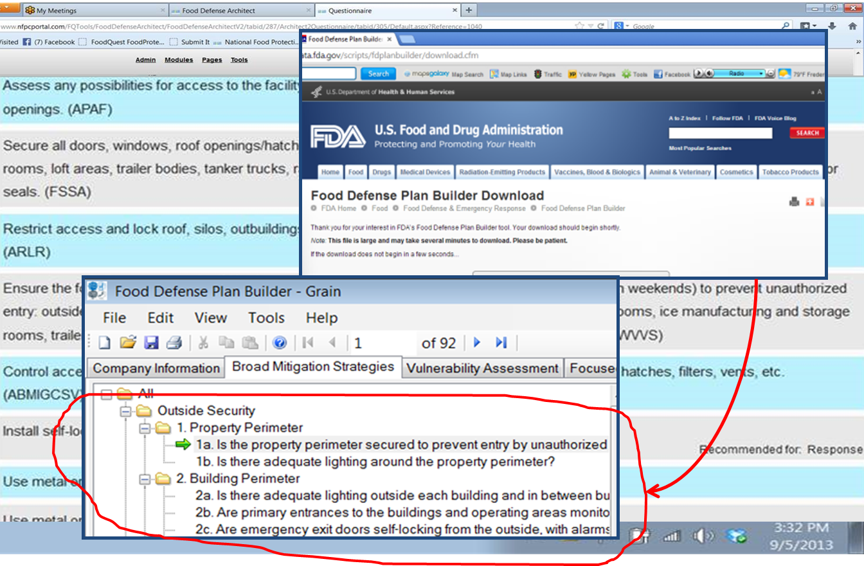
Examples of FDA Plagiarism of FoodQuestTQ Products
FQTQ: Food Defense Architect
FDA: Food Defense Plan Builder
Notes:
In December 2012 the FDA released a new tool called Food Defense Plan Builder. FDA was already familiar with our Food DefenseTQ tool. They were briefed on the new tool over a year earlier. The FDA was fully aware of our Food Defense Architect Tool. Both of these tools are designed for the food industry to build food defense plan. Both tools were already being sold by my company to the food industry.
In this example, you can see that the FDA took our ideas and research for structuring our Food DefenseTQ questions and the criteria for building food defense plans in Food Defense Architect to build FDA’s Food Defense Plan Builder. Yet another example of intentional plagiarism by the FDA.

Slide 13
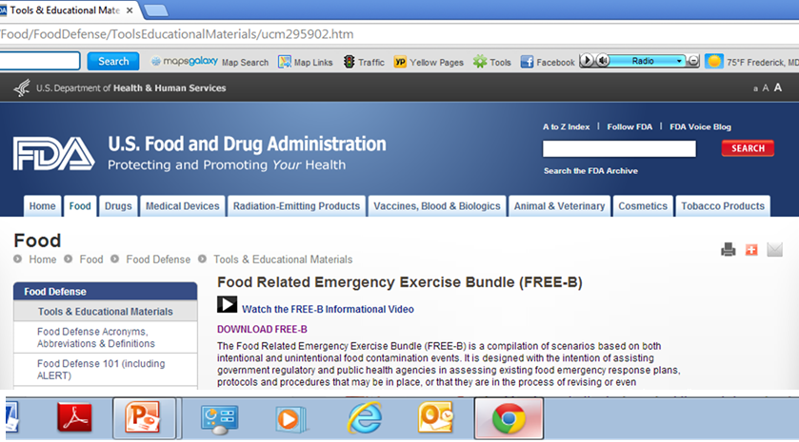
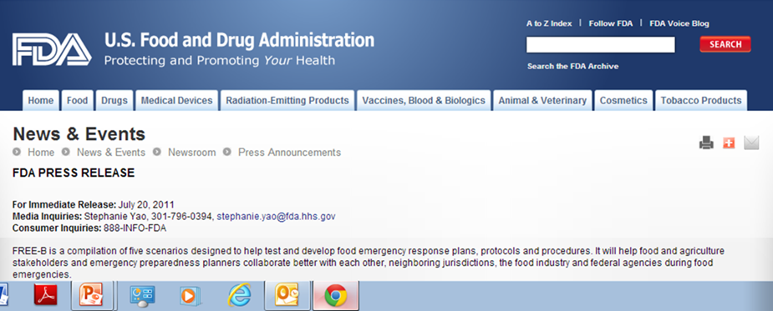
Examples of FDA Plagiarism of FoodQuestTQ Products
FQTQ: FREE (Food Response Emergency Evaluation) Tool
FDA: FREE-B (Food Related Emergency Exercise Bundle
Notes:
In 2010, I developed a new computerized tool to help the food industry test and develop food emergency response plans, procedures and protocols. It was based on my research into the use of simulations as a teaching and learning tool. Long before FDA began to build their FREE-B tool, they were briefed on our FREE tool.
In July 2011, the FDA released FREE-B. Again, the FDA plagiarized our use of carefully structured scenarios loosely based on real world events to create food emergency preparedness learning environments designed to bring together multidisciplinary stakeholders to improve responses.
The idea of using these types of structured environments goes back to the research I conducted at the George Washington University prior to 2004.

Slide 14
http://www.youtube.com/watch?v=xKHdJhGLQok
Notes:
If you are interested in supporting efforts to hold the government accountable for plagiarism and the violation of research integrity, we ask that you visit the above link watch the short video there and sign the petition calling for action to hold the government accountable for violations of research integrity and unfairly competing with small business across America.

