Slide 1
Food Protection
Bruce Becker (CW ret.)
President
FoodQuestTQ
Notes:
Hello. I’m Bruce Becker and we are here for our second session on the general topic of food defense.

Slide 2
Food Protection
SESSION 2: conducting a food defense hazards analysis
Notes:
Today’s session is on the topic of conducting a food defense hazards analysis.

Slide 3
Four (4) Sessions
1. Threats to the Food Supply
2. Conducting a Food Defense Hazards Analysis
3. Food Defense Risk Assessment
4. Building a Food Defense System
Notes:
In the first session, we talked about threats to the food supply based on the extensive research that has been done by our scientific staff at FoodQuestTQ. Basically what talked about in Session 1 was “What can happen” to the food supply and food operations.
In this session, we will talk about some of the ins and outs of conducting a hazards analysis as a distinct, but closely interrelated activity, with conducting a threat assessment. Basically, what we will be talking about is how the threats we identify in our first session can materialize in food operations.
In session, three we will explore ways to scientifically determine the levels of risk we face based on the results of food defense threat assessments and hazards analyses.
Our last session will be devoted to taking the things we talk about in sessions 1-3 and using this knowledge to build a robust food defense program.
Again, please feel free to stop and ask me questions.

Slide 4
The Food Defense End Game
Threat Assessment
Hazards Analysis
Risk Assessment
Food Defense System
Step 4.
Step 3.
Step 2.
Step 1.
Notes:
Over the course of the workshop we are going to discuss the essential foundation upon which any effective food defense system must be based.
In this first session we focused on the threat. The term threat has a very specific definition based on the idea of identifying what can happen.
A threat assessment should not be confused with a hazards analysis. A hazards analysis answers the question if a specific target is exposed to the different threats that are identified in your threat assessment.
A risk assessment tells you the degree or extent of exposure of a specific target to the different threats and hazards you identify.
The end game is to build robust food defense systems that reflect the results of your threat assessment, hazards analysis and risk assessment.

Slide 5
Definition of a Food Defense Hazard
The potential exposure of a specific target along the food supply chain to a given threat
A hazards analysis considers
What can happen
Adversary motivation, planning, knowledge and resources and ability to successfully execute their plan of attack
The variability of exposure based on:
The threat environment
The type of adversary you are dealing with
Your location on the food supply chain
The specific commodity you are dealing with
Notes:
A food defense hazard is defined as the potential range of exposure of a specific target along the food supply chain to the different types of threats we talked about in Session 1.
A good hazards analysis considers the results of your threat assessment, the characteristics of the adversary, the threat environment, the specific type of adversary you are dealing with, your location on the food supply chain and the specific commodity you are dealing with.

Slide 6
Session 2: Conducting a Food Defense Hazards Analysis
How can the different food defense threats impact your operations?
Strategic, operational and tactical intelligence to help identify the hazards
Hazards are variable
Must identify the hazards associated with each type of threat:
What is the likelihood of occurrence?
What are the worst case consequences of a successful attack?
You must consider the threats and their associated hazards in context
Notes:
Now, one of the important ways to get a handle on your potential exposure to different threats is by taking advantage of strategic operational and tactical intelligence. So, in this session we will spend some time talking about the role that intelligence plays in any robust food defense system.
The second we will talk about is the variability of hazards. In other words, your exposure is not the same depending on the type of adversary you are dealing with, your location on the supply chain and the specific commodity you are dealing with.
Hazards must be considered in the context of each type of different threats and the likelihood that they will occur and how serious the consequences of a successful adversary attack would be.
Finally, your exposure to different threats must be considered in the context of different adversary types; your specific location on the supply chain and the specific commodity you are dealing with. In other words there is no “ones size fits all” solution to the challenges posed by food defense.

Slide 7
Strategic Intelligence to Help Identify Food Defense Hazards
Gathering and analysis of strategic country intelligence
Incidents by country and regions
The stability of the country and region
Enforcement and Judicial System
International rules of law and banking system
Levels of government corruption
Presence of a food safety system
Quality of government oversight and enforcement
Presence of organized crime
Human and drug trafficking; child labor
Incidence of fraud in general and food fraud in particular
Notes:
The first way you can leverage intelligence to help you understand you exposure from food defense threats is to gather and analyze strategic country intelligence. This intelligence includes things like:
Food defense incidents in the country or region;
The political stability of the country and the region that includes the presence of law enforcement and a judicial system; that the country is following international rules of law including those relating to banking, and; levels of government corruption.
Another valuable piece of intelligence that is directly correlated to your exposure is the presence of a food safety system in the country and the quality of government oversight and regulation.
Number four on the list is the presence of organized crime. The indicators and warnings of organized crime include things like human and drug trafficking, child labor money laundering and others.
Last but not least is the general frequency of fraud and corruption in general and incidents of food fraud in particular.

Slide 8
Food Fraudster Service

Slide 9
Operational Intelligence to Help Identify Food Defense Hazards
Gathering and analysis of in-country statistics
Past Attacks and frequency over time by:
In-country location
Commodity type
Location on the supply chain
Type of Adversary
Present and potential exposure
Notes:
Of course, the more specific you can get the better. This is where operational intelligence is important. For example, if you have access to information about past attacks and frequency over time these can be significant indicators of potential and future exposure.

Slide 10
Again From Our Food Fraudster Tool

Slide 11
Tactical Intelligence to Help Identify Food Defense Hazards
Gathering and maintenance of facility specific information
Company registration
Results, quality and frequency of facility inspections by state authorities
Past history of food safety and food fraud incidents at the facility
Local presence of law enforcement
Presence of localized organized crime
Local crime demographics
Present and potential facility specific threats
Notes:
And then we have tactical, or in other words, facility specific intelligence that includes things like:
Company registration, results, frequency and quality of inspections and audits by state, regional and local authorities and past history of food safety and food fraud incidents involving the facility.
The local presence and relationship with law enforcement authorities is another important indicator of exposure. The presence of organized crime and local crime demographics can also be useful.
Finally, whether the facility is doing their own scanning of the environment to identify present or potential threats to their own operations can be an important indicator of exposure.

Slide 12
Food Defense Hazards are Variable
Environment
The strategic, operational and tactical environment in which you are operating
Adversary Type
Crusaders
Location
Growers
Criminals
Crazies
Transporters
Processors
Storage and distribution facilities
Retailers
Commodity
Meats
Produce
Dairy
Non-dairy
Notes:
As I alluded to a few minutes ago food defense hazards or the degree of your exposure to potential threats varies depending on:
Your specific threat environment;
The type of adversary you are dealing with;
Your specific location on the supply chain, and;
The specific commodity you are dealing with.
To systematically structure their scientific analyses our scientists look at the strategic, operational and tactical environment; the three adversary types of crusaders, criminals and crazies; the five supply chain segments of growers, transporters, storage and distribution and retailers, and; the range of different commodities.

Slide 13
Extra Virgin Olive Fraud as One Example
Environment
Strategic | 69% of extra virgin olive oil imported into the U.S. from Europe is falsely labelled
Operational | European food fraud enforcement of exported olive oil is lacking
Tactical | All aspects of the olive oil supply chain in Europe have been infiltrated by the criminal element
Notes:
So, for example let’s take a look at virgin olive oil fraud as a food defense example. At the strategic intelligence level a study by Stanford University found that 69% of the olive oil imported into the United States from Europe that is labeled as extra virgin olive oil has been adulterated. The same study showed that 10% of California extra virgin olive oil is adulterated.
At the operational level we know that European and U.S. enforcement regimes to combat food fraud are weak to non-existent in some cases and that olive oil fraud is extremely widespread.
At the tactical level we know that most olive oil fraud occurs at the processing level by cutting extra virgin olive oil with inexpensive substitutes and selling mislabeled products.
At the tactical level we also know that the major processors of olive oil throughout Europe have been infiltrated by organized crime. We also know that olive oil fraud occurs at the transportation, storage and distribution and retail sales segments of the food supply chain by organized crime and the petty shyster.

Slide 14
Extra Virgin Olive Fraud as One Example
Adversary Type
Organized Crime | Operate primarily at the processor level
 | Adulterate and mislabel product
Petty Shysters | Operate primarily in the transportation, storage and distribution and retail segments
 | Steal, may adulterate and re-label product
Notes:
Based on our strategic, operational and tactical knowledge of the extra virgin olive oil fraud environment we know that our greatest exposure comes from organized crime and the petty shyster.
Because organized crime looks for continuous flows of revenues over the long term we know that they are operating primarily at the processor level by adulterating, i.e., cutting with less expensive oils, and mislabeling product. The practice has been going on in Europe for millennia.
Because petty shysters look for targets of opportunity they operate primarily in transportation, storage and distribution and retail segments of the supply chain looking to use cheaper inferior grades of already bottled olive oil and re-label them as the more expensive extra virgin grade.

Slide 15
Extra Virgin Olive Fraud as One Example
Location |  | Commodity Type
Processor | Adulterate product in process | Extra virgin olive oil
 | Mislabel outgoing product
Transportation | Steal shipments of olive oil
 | Adulterate product
 | Bottle or re-label bottled product
Storage | Re-label bottled product
Distribution
Retailer
Notes:
From our knowledge of the strategic, operational and tactical intelligence as it relates to the specific commodity of extra virgin olive oil, the types of adversaries we are dealing with including their motivation and characteristics and their location along the supply chain we can begin to formulate our true exposure to the threat of olive oil fraud.

Slide 16
Identifying the Hazards Associated with Each Type of Threat: Intentional Poisoning
Mass Poisoning
What agents could be used?
Dose rate
Homogenously mixed
Symptoms onset delay factor
Where and how easily can the “right” agent be obtained?
Knowledge of plant processing systems and equipment
How much can you learn by observation?
What details would you have to know about the system and equipment before you could mount a successful attack?
Where can you get the information?
Access to large batch processing
Access controls
Critical “mixing” points
Personnel reliability program
Materials entry security
Notes:
This next series of slides should be somewhat familiar to you in the context of our first session on the threat to the food supply and our discussion of the different types of things that can happen to the food supply.
As we review these slides I want you to shift your focus from what can happen to how do the threats materialize. Our focus is now on our exposure or the hazards posed by the different threats we talked about in session 1.
So when it comes to determining our exposure to the possibility of mass poisonings by terrorists or religious cults we need to answer some questions. Things like how hard would it be for the adversary to find the right agent? Could it be effectively mixed in a massive amount of food? Does a potential adversary know or could he find out enough information to mount a successful attack? Could the adversary successfully execute his mission?

Slide 17
Identifying the Hazards Associated with Each Type of Threat: Intentional Poisoning
Group Poisoning
What agents could be used?
Dose rate
Homogenously mixed
Symptoms onset delay factor
Where and how easily can the “right” agent be obtained?
Knowledge of food preparation systems and equipment
How much can you learn by observation?
Access to food preparation areas
Access controls
Critical “mixing” points
Personnel reliability program
Materials entry security
Notes:
When it comes to the possibility of an adversary trying to poison tens to hundreds of people many of the questions are the same as a mass poisoning. Questions like: How hard would it be for the adversary to find the right type of agent to poison a large number of people? Could the agent be effectively mixed in a large amount of food without being detected by the victims? What would the adversary have to do to administer the poison? Would he have to have access to food preparation areas?

Slide 18
Identifying the Hazards Associated with Each Type of Threat: Intentional Poisoning
Transitory Poisoning
What agents could be used?
What, where and how easily can the “right” agent be obtained?
Dose rate
How administered?
Symptoms onset delay factor
Knowledge of food chemistry, human anatomy, effects of agents
How much can you learn by observation?
Access to food preparation and consumption areas
Personnel reliability
Surveillance programs
Notes:
Transitory poisonings also require the right agent…and ways to clandestinely administer it…such as mixing or tampering with product along the lines of the ketchup scenario shared with you in lesson 1. If you ran a restaurant, could an adversary introduce an agent into the food you prepare in the kitchen? Could he poison food at the salad bar? Would an insider have to be involved?

Slide 19
Identifying the Hazards Associated with Each Type of Threat: Intentional Poisoning
Individual Poisoning
What agents could be used?
Numerous physical, chemical and biological agents
How administered?
Access to food and beverage
Access
Tamper indication
Notes:
How likely is it that someone in your facility would poison the food you produce or sell? What agents would you have to consider? Would it or could it involve an insider? What are the different ways it could be done? Again the list goes on and on.

Slide 20
Identifying the Hazards Associated with Each Type of Threat: Intentional Poisoning
Economically Motivated Adulteration of Food
What agents could be used?
To do what and how?
Access to food and beverage
Notes:
Next we have the hot topic of food fraud. What agents could be used to accomplish what purpose (horsemeat in ground beef, HFCS in honey, lesser grains of rice in the more expensive rice, melamine in pet and baby food). How can the adversary access the food and/or beverages he wants to adulterate. And, the list goes on.

Slide 21
Identifying the Hazards Associated with Each Type of Threat: Disruption
Disruption
How could an adversary disrupt your operations?
Sabotage?
Facilities, equipment, product
Cyber sabotage
Notes:
Finally, we have the issue of disruption. How and what would the adversary have to do to disrupt your operations.

Slide 22
Hazards Analysis Tools: DBT
DBT Strengths | DBT Weaknesses
Can be well engineered | Fixed threat level
Conducive to budgeted upgrade plans | Does not consider integration of infrastructures
Principally an engineering tool | May not address human in the loop vulnerabilities
Clear design cost | No connect between design and changing threat environment
Strong traditional physical security focus | Not used for all hazards threats
Notes:
Definition: (DOD) Design Basis Threat is the threat against which an asset must be protected and upon which the protective system's design is based.
It is the baseline type and size of threat that buildings or other structures are designed to withstand.
The design basis threat includes the tactics aggressors will use against the asset and the tools, weapons, and explosives employed in these tactics. Also called DBT. (JB 3- 07.2)
We realize that all facilities face a certain level of risk associated with various threats. These threats may be the result of natural events (earthquake), accidents (car driving into your building), or intentional acts to cause harm (Oklahoma City Alfred P. Murrah Federal Building). Regardless of the nature of the threat, facility owners have a responsibility to limit or manage risks from these threats to the extent possible.
Design Basis Threat http://www-ns.iaea.org/security/dbt.asp?s=4

Slide 23
Hazards Analysis Tools: HACCP
HACCP Strengths | HACCP Weaknesses
Globally-accepted | Designed to Control Only Identified Hazards
Preventive System in Controlling Hazards | Limitations for operations outside of food processing facilities
Does Not Rely upon Finished Product Testing | Known and Designed for Food Safety Applications only - not “all hazards” applications
Same strengths as DBT | Same weaknesses as DBT
Notes:
All of us in this room, I believe are familiar with Hazards Analysis Critical Control Point Programs that are used throughout the food industry.
Several important strengths: include wide acceptance, designed to control hazards, and is logically engineered. Among the weaknesses of HACCP include it’s strong focus on food safety as opposed to food protection (which include food defense), it is internally focused and may not consider “human in the loop” scenarios especially when acts are intentional.

Slide 24
Hazards Analysis Tools: ORM
ORM Strengths | ORM Weaknesses
Well-known | Qualitative, i.e., subjective, inputs
Can be used to address both Low Probability/High Consequence and High Probability/Low Consequence Events | Difficult to use under time pressure
Somewhat structured approach to safety and security planning | Risk values in the risk matrix are not validated against science-based standards
Easily used and understood | Avoids the reality of complex interdependencies around risk
Relatively inexpensive to use | Provides no cost/benefit comparison in managing risk
Notes:
The term Operational Risk Management (ORM) is defined as a continual cyclic process which includes risk assessment, risk decision making, and implementation of risk controls, which results in acceptance, mitigation, or avoidance of risk. ORM is the oversight of operational risk, including the risk of loss resulting from inadequate or failed internal processes and systems; human factors; or external events.
The Food & Drug Administration³ and USDA FSIS were early adopters of ORM for food defense application immediately after 9/11. Industry also adopted the ORM risk methodology for food defense applications.
The FDA, with the voluntary participation of food industry trade associations, subsequently conducted a series of ORM exercises and published a series of Food Security Preventive Measures Guidance documents for the Industry

Slide 25
Hazards Analysis Tools: PRA
PRA Strengths | PRA Weaknesses
Proven for evaluation of sensitive and critical industrial/government system risk | Results stated as ranges or as a series of values modified by confidence levels or percentiles, rather than as signing single values
Multivariate methodology | Risk difficult to communicate to public because of non-deterministic (non end-point) values
Allows the use of probability distribution assumptions to value risk | Complex interdependencies around risk values are not dynamic
Based on quantitative consequence analysis | Does not address complex human in the loop vulnerabilities
Notes:
Probabilistic Risk Assessment (PRA)¹: Probabilistic Risk Assessment (PRA) is used to estimate risk by computing real numbers to determine what can go wrong, how likely is it, and what are its consequences. Thus, PRA provides insights into the strengths and weaknesses of the design and operation and is mostly used in the nuclear industry.
There are different levels 1 - 3. A Level 1 PRA models the various plant responses to an event that challenges plant operation. Level 2 PRA models the plant's response to the Level 1 PRA accident sequences. And Level 3 PRA is often called a consequence analysis. Consequences result from the radioactive material released in a severe accident.
Probabilistic Risk Assessment Techniques http://www.youtube.com/watch?v=CZODGfWwH_0&feature=player_embedded
Probabilistic Risk Assessment (PRA) http://www.nrc.gov/about-nrc/regulatory/risk-informed/pra.html#Level1

Slide 26
Hazards Analysis Tools: C.A.R.V.E.R. + Shock
C.A.R.V.E.R. plus shock Strengths | C.A.R.V.E.R. plus shock Weaknesses
Software Ready | Risk stated as single deterministic values based on qualitative inputs
Structured | Qualitative inputs drive outputs
FDA and USDA Sanctioned | Avoids the reality of changing complex interdependencies around risk
Better than nothing? | Focuses on external individual attacker without enough regard for insider assistance
 | Not science-based
 | Not Useful for food safety assessment
 | Does not address all hazards
Notes:
C.A.R.V.E.R. plus Shock is a food defense offensive prioritization tool that can be used to in the food industry to assess the vulnerabilities within a system or infrastructure in the food industry. By conducting a CARVER + Shock assessment of a food production facility or process, the user can focus resources on protecting the most susceptible points in their system.
CARVER is an acronym for the following attributes used to evaluate the attractiveness of a target for attack:
Criticality—public health or economic impact
Accessibility - ability to physically access and egress from target
Recuperability - ability of system to recover from an attack
Vulnerability - ease of accomplishing attack
Effect - amount of direct loss from an attack as measured by loss in production
Recognizability - ease of identifying target
There are weaknesses with CARVER + Shock and you can read what they are on the slide.
¹CARVER Software http://www.fda.gov/Food/FoodDefense/CARVER/default.htm

Slide 27
Tools Summary
Qualitative vs. Quantitative
Dynamic vs. Static
Interdependencies
Human in the Loop
Garbage in and Garbage Out
Changes in the Threat Environment

Slide 28
Hazards Analysis: The Bottom Line
All hazards analysis tools have limitations
Only as good as the person applying the tools
Easy for non-experts to “go Hollywood”
Based on engineering principles
Not enough integration of the “human factor” into the process
Degrees of exposure are expressed in complex mathematical terms or are highly subjective
They produce point in time results
Notes:
In the end analysis, all of the hazards analysis tools we use have serious limitations one way or another.
In many cases you must have highly experienced people at the controls so to speak. It’s very easy to over or underestimate your exposure because too often the results are not the product of multidisciplinary inputs and may not reflect what the bad guy will actually do.
All of the tools have some serious common problems including the integration of the human factor and, quite frankly, humans do not always follow engineering principles. Another serious problem is that the results are static and produce only point in time results. All of us in this room know better than that.
The threats and our exposure to them are always changing.

Slide 29
The CSM METHOD®
2000-2006 program of research at GWU on complex adaptive systems
A new method for scientifically quantifying the behaviors of complex systems
One of the areas it was applied to was the food supply
Intended to make up for the weaknesses in today’s threat assessment, hazards analysis and food defense planning
The CSM METHOD®:
“Projects” versus “predicts” future systems behaviors based on quantitative analysis
Changes the approach from subjective opinion to science-based logic
Focus is on prevention wherever possible and response whenever necessary
Uses new “big data” capabilities
Takes account of critical infrastructure interdependencies, qualitative versus quantitative reasoning, dynamic real time treatment of data, avoids the garbage in garbage out syndrome, continuously scans the threat environment
Provides a systems model for food protection
Notes:
To address the shortcomings of these threat assessment and hazards analysis tools a program of research was undertaken at the George Washington University. The program lasted for six years and won an award from the Potomac Institute in 2004. The results of the research are now patented and have been used by the Food and Drug Administration to develop their Food Protection Plan and a number of computer-based food defense tools that appear at their website.
The CSM Method projects what can happen using probability theory and the statistical analysis of “big data” drawn from the cloud. So it’s not a so-called form of “predictive analytics.” Predictive analytics have very serious scientific shortcomings because we try use them to predict very specific events. Science tells us that you cannot really exactly predict anything.
The CSM approach uses science-based logic versus subjective opinion to avoid the garbage-in garbage-out syndrome. And, it provides a systems model for the protection of critical infrastructures including the food and agricultural vertical.
In Sessions 1 and 2 we have already introduced you to much of this new thinking. In Sessions 3 and 4 we are going to share more of this new thinking about protecting the food supply.

Slide 30
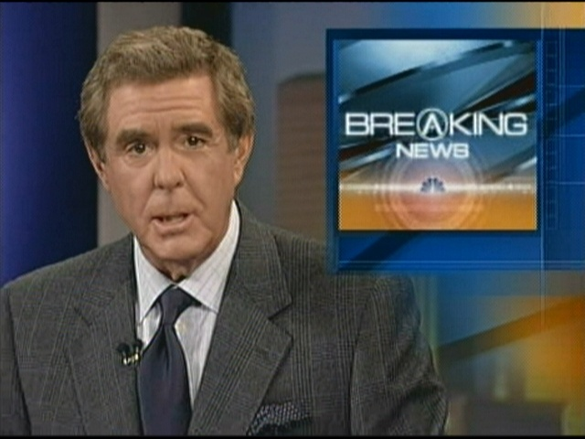
May 1, 2010: 1300 Hours

Slide 31
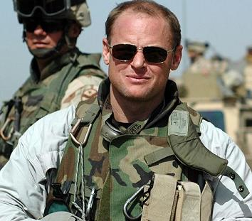
Bagram Airfield, Afghanistan

Slide 32
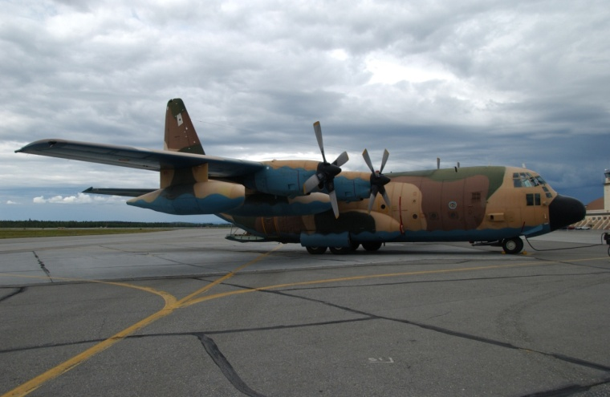
Airport

Slide 33
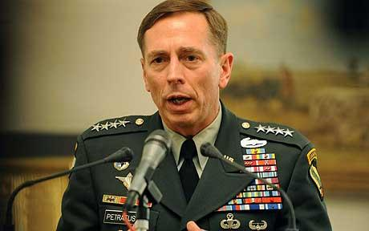
General David Patraeus

Slide 34
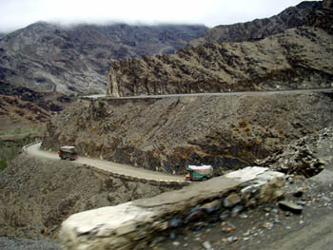
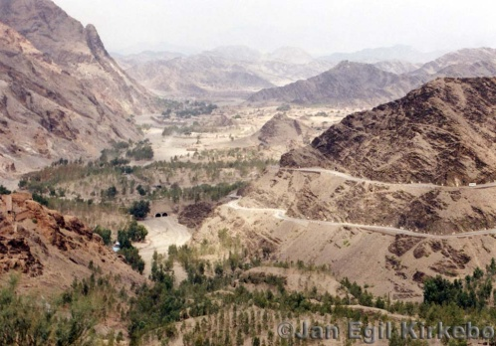
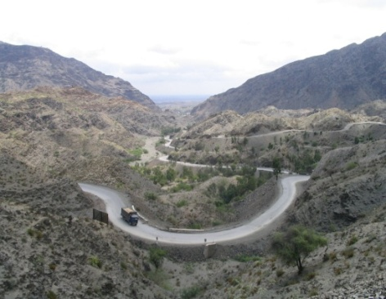
Khyber Pass

Slide 35
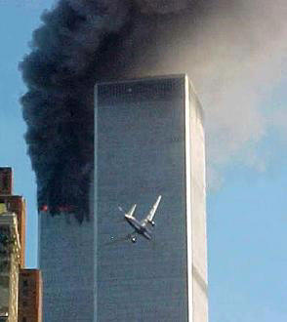
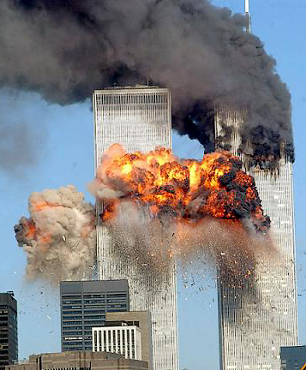
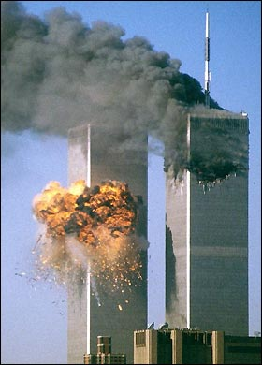
September 11, 2001

Slide 36
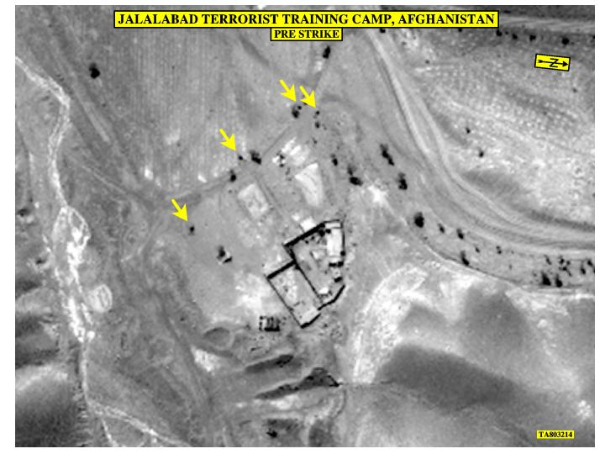
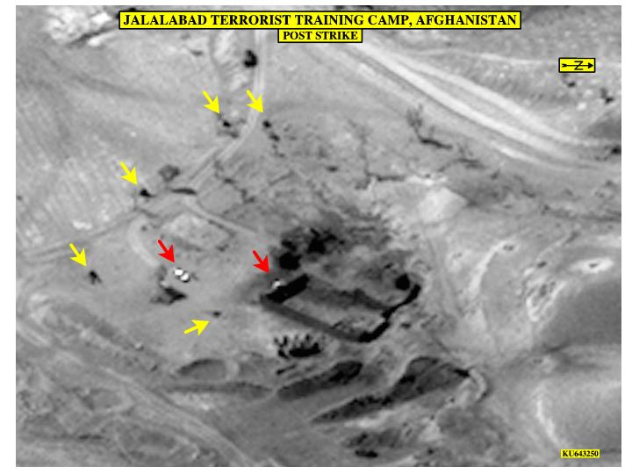
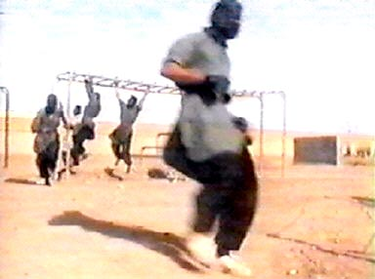
Abu-Khabab: Jalalabad Terrorist Training Camp
Copyright © 2014 All Rights Reserved FoodQuestTQ LLC

Slide 37
January 19: 2010: State of the Union Address

Slide 38
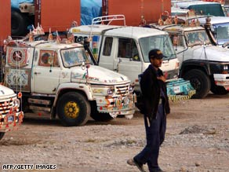
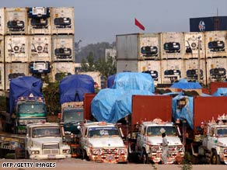
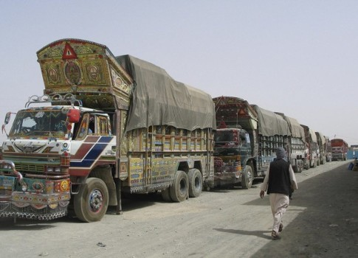
Manas Depot, Pakistan

Slide 39
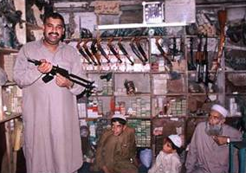
Local Arms Bazaar, Manas, Pakistan

Slide 40
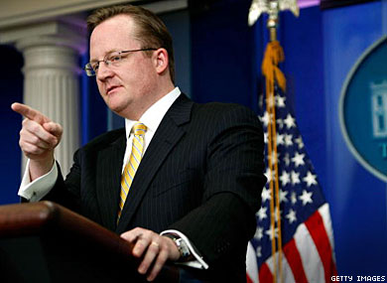
Robert Gibbs, White House Press Secretary

Slide 41
General Stanley McChrystal

Slide 42
Jeffrey Archer Bagram Airfield, Afghanistan

Slide 43
Joe Barber, NTN News

Slide 44
Questions
What are the threats
What can happen
What are the hazards
How can the threat materialize given the depot
Means and Methods of adversary are critical understand the extended order of affects
Location on the supply chain

Slide 45
Manas Depot
Threats
Disruption of the food supply
Intentional Poisoning
Transitory attack
Sabotage
Economic loss and the cost of war
Hazards
IED
Small arms
Taliban attack
Well placed attack at narrow passageways along Khyber pass
Personnel security for Pakistani truck drivers and contractors
…

Slide 46
Summary of Session 2
The definition of hazards analysis
How strategic, operational and tactical intelligence can help us in conducting a hazards analysis
The variability of food hazards along the supply chain
A mini hazards analysis using the economically motivated adulteration as an example
Reviewed the strengths and weaknesses of some of the most commonly used tools for hazards analysis
Notes:
OK, that’s the conclusion of session 2. We have just uudefined what a hazards analysis is; how strategic, operational and tactical intelligence can give us an idea of our extent of exposure to different threats; the variability of hazards along the food supply chain.
We also discussed the strengths and weaknesses associated with several of the tools that are being used with mixed results to help us think through a hazards analysis.
In our next session we will talk about the third essential building block we must have in place to build a robust food defense system.
Thank-you.

